Slide 1

Fostering Connections
Building Community

Slide 2




Who we are
Why
Entrepreneurs need Mentors …
… Mentors need Entrepreneurs
They just have to FIND each other
What
MentorApp is a AI powered Tinder-like tool that connects the Mentors and Entrepreneurs globally. MentorApp is vibrant tech-environment that brings in the best elements of the entrepreneurial ecosystem for a mutually beneficial interaction that is both satisfying and remunerative.
How
AI powered platform using proprietary ML techniques and deep mining the ecosystem. Selects the perfect match for what the entrepreneur wants with the what mentors have to offer . It’s a subscription based platform that lets subscribers effectively monetise their interactions.
MENTORAPP
Fostering Connections
Building Community

Slide 3
Problem/Opportunity
CONTEXT When does the problem occur? Startup Right from starting up Mostly while searching for a co-founder, product-market fit validation, business model validation, product development stage, financial planning, marketing and promotion, growth predication, raising funds Only a few mentors are available through personal networks Whenever there is an immediate need Poor outcome/solution from the mentoring Mentor During mentor-mentee conversations During scouting the right startups for mentorship Usually when the mentor wants to monetize her services Learning from personal experience | PROBLEM What is the root cause of the problem? Startup Very nascent and have lack of entrepreneurial skills Very young startup founding team and many have little experience after their graduation Peer-pressure to be part of the startup spree Not enough networked Limited resources and perks to onboard fulltime mentors Lack of availability of mentors within personal network Mismatch for startup and mentor Mentor Good visibility in ecosystem but limited personal branding Unorganised mentoring format No mentor-mentee tracking Low rewards and mostly pro-bono Difficult to scout right startups A lof of time is wasted Mismatch of mentor and mentee startup | ALTERNATIVES What do customers do now to ﬁx the problem? Startup Consult lawyers, CA’s, Business Consultants Try to seek help from their network, professors of management, reliable friends/ family/relatives who are doing their businesses On-board mentors with limited knowledge skill in exchange of equity Learn from entrepreneurship books, websites, blogs, articles, online courses, incubators, accelerators
CUSTOMERS Who has the problem most often? Startup Mostly very young and early stage startups Revenue and growth stage too want business mentors | EMOTIONAL IMPACT How does the customer feel? Startup Confused, frustrated and sometimes lost Under confident Over priced Lack of trust, respect and credibility due to poor outcomes or no outcomes | ALTERNATIVE SHORTCOMINGS What are the disadvantages of the alternatives? Startup Lawyers and CA’s and business consultants are pricy Mostly have domain-specific knowledge, sometimes outdated; may not be relevant right at the starting up phase. Sometimes too busy to provide meaningful time May be good for financial management but not for the business execution, strategies and growth Books are time-consuming, mostly generic, not very updated Articles, blogs, websites are too many, time-taking to search the right one, not able to provide much-needed information Mentors Lack of proper platform for provide mentoring Offline mentoring is time-consuming and costly Limited scope and less rewarding
 | QUANTIFIABLE IMPACT What is the measurable impact (include units)? Startup Achieve more in less (less time, les money) Increase in sales more than double Survive for more than 5 years with faster access to external investment Mentor Provide focussed mentoring in just a few hourly slots Reduces search time to find the right startup by more than 50% Increased numbers of mentee connection requests

Slide 4
Entrepreneur Interview Results
No. of entrepreneurs interviewed = 100
Word of Mouth:
I struggle to get the right mentors”
Fellow entrepreneurs also face a similar struggle – we try to help each other”
I can’t tell you how many times I have called a mentor and explained my business, only to realize that s/he may not be able to help me”
I regularly exchange notes with other entrepreneurs if I feel a mentor is good or has too much hype”
MENTORAPP
Fostering Connections
Building Community

Slide 5
Mentor Interview Results
No. of mentors interviewed = 50
Word of Mouth:
“I have to spend a long time listening to entrepreneurs before figuring out if I can help them or not”
“I find it difficult to keep track of my conversations”
“I face scheduling challenges”
“I wish I could get I could also expand my network”
“I want to take up mentoring full –time; but I am hesitant to ask struggling entrepreneurs for a fee”
MENTORAPP
Fostering Connections
Building Community

Slide 6


Problem / Opportunity
Start-up:
Do not have easy access to mentors and experts
Have to rely on my network and hence may not be connected to the best mentor for my problem areas
Don’t have any reliable information on how helpful the mentoring conversation would turn out to be
Mentor:
The mentoring sessions are unorganized
Mentor can’t follow through to see if the mentees actually took the advice.
Unable to showcase these sessions and establish credibility
The time spent on these sessions is high; the sessions are generally free; no tangible return on the time and effort expended.
MENTORAPP
Fostering Connections
Building Community

Slide 7
Market Size Estimation
6M entrepreneurs are looking for mentoring
There are 0.6 M mentors. The mentor market needs to develop and grow to meet the demand of the entrepreneurs.
Presently, there is dearth of structured mentor development programs
At first, the market will be served by getting these 0.6 M mentors on board.
As the model matures, entrepreneurs would also become mentors and thus keep feeding back to the mentor pool.
741 M
37 M
6 M
Total Pop^{n} 18 – 64
Estimated Entrepreneurs
(approx. 6% of the Pop^{n} )
Total Addressable Market
(approx. 15% of the estimated Ent^{r} )
62 M
0.6M
No. of Professionals on Linkedin (India)
Estimated no. of Mentors
(1% of the Professionals)
MENTORAPP
Fostering Connections
Building Community

Slide 8

Persona – Entrepreneur
Risk takers
Self-motivated
Passionate
Motivations
Goals
Business Sustainability
Become the next-big thing
Receive investor interest and funding
Secure financial future for self and family
Frustrations
Not receiving the desired level of customer traction
Lack of connection to mentors and experts
Getting an audience with investors
I am in love – I eat, sleep and breathe my venture every moment of the day. I will make it happen.”
Age: 25 - 35
Work: Entrepreneur
Location: Sec A / Sec B cities
Bio
Krish has started his venture about a year ago. Presently, he is at POC stage and has some customers. The venture has yet to achieve its breakeven. He needs to make the venture sustainable so that he can start planning for funding to fuel his next level of growth.
He believes the solution has an immense potential to carve out a niche for himself and might end up changing the market dynamics. He is open to take guidance from the mentors, and experts to take his business to success.
He attends different entrepreneurial seminars and tries to network with experts. He makes an effort to discuss his business challenges with similar-minded people. At times, he becomes defensive and is unreceptive to strategic advice that is not conducive to his line of thought. At the same time, he is riddled with the fear of losing personal financial security, unfavorable market feedback and lack of investor interest.
Personality
MENTORAPP
Fostering Connections
Building Community
Notes:
Extraversion (E) – Introversion (I)
The extraversion-introversion dichotomy was first explored by Jung in his theory of personality types as a way to describe how people respond and interact with the world around them. While these terms are familiar to most people, the way in which they are used in the MBTI differs somewhat from their popular usage.
Extraverts (also often spelled extroverts) are "outward-turning" and tend to be action-oriented, enjoy more frequent social interaction, and feel energized after spending time with other people. Introverts are "inward-turning" and tend to be thought-oriented, enjoy deep and meaningful social interactions, and feel recharged after spending time alone.
We all exhibit extraversion and introversion to some degree, but most of us tend to have an overall preference for one or the other.
Sensing (S) – Intuition (N)
This scale involves looking at how people gather information from the world around them. Just like with extraversion and introversion, all people spend some time sensing and intuiting depending on the situation. According to the MBTI, people tend to be dominant in one area or the other.
People who prefer sensing tend to pay a great deal of attention to reality, particularly to what they can learn from their own senses. They tend to focus on facts and details and enjoy getting hands-on experience. Those who prefer intuition pay more attention to things like patterns and impressions. They enjoy thinking about possibilities, imagining the future, and abstract theories.
Thinking (T) – Feeling (F)
This scale focuses on how people make decisions based on the information that they gathered from their sensing or intuition functions. People who prefer thinking place a greater emphasis on facts and objective data.
They tend to be consistent, logical, and impersonal when weighing a decision. Those who prefer feeling are more likely to consider people and emotions when arriving at a conclusion.
Judging (J) – Perceiving (P)
The final scale involves how people tend to deal with the outside world. Those who lean toward judging prefer structure and firm decisions. People who lean toward perceiving are more open, flexible, and adaptable. These two tendencies interact with the other scales.
Remember, all people at least spend some time extraverting. The judging-perceiving scale helps describe whether you extravert when you are taking in new information (sensing and intuiting) or when you are making decisions (thinking and feeling).

Slide 9
Value Proposition Canvas
Persona – Entrepreneur
I would LOVE it if:
I receive connects with industry – customers, suppliers, and service providers etc.
I receive connects with Funding Agencies
I receive specific inputs on Pitching
→ I receive data and intelligence on market trends and competitors
→ Promote my events, success stories etc.
Access to Mentor’s Network (based on Mentor’s discretion)
Perfect your Pitch Sessions with Pitch Mentors
Discussion Forum / Notice Board to post updates on your start-up
Access to market trends, data and analytics that the start-up can use
The MentorApp is a AI powered platform using proprietary ML techniques to match-make the specific needs of the start-up and the profile of the Mentor/Expert
MentorApp tracks the progress of the start-up, provides reliable data on the efficacy of the mentoring conversations and sets up a developmental journey for the Mentor.
GAIN CREATORS
GAINS
PRODUCT/
SERVICE
I would WANT:
Easy and Convenient Access to Mentors and Experts
An opportunity to assess the credibility of the Mentor
An opportunity provide feedback on the efficacy mentoring conversation
To build my network – connect with other entrepreneurs
Share my story, my trials and tribulations
JOBS
PAIN KILLERS
PAINS
I would HATE it if:
If I am connected to experts, mentors who do not “get” me and my idea
If I feel ‘obliged’ to follow advice
My idea gets ‘stolen’
Perfect matchmaking with experts, mentors
Exposure to the right kind of Investors
MENTORAPP
Fostering Connections
Building Community

Slide 10
Persona – Mentor
Eager to give back
Knowledgeable
Experienced
Motivations
Goals
Build a brand for self
Give back to the community
Expand my network
Frustrations
Non committed entrepreneurs
Unorganized mentoring sessions
I love entrepreneurs – I am in awe of their struggle and tenacity. I want to give back so that they can learn from my mistakes!
Age: 40-45
Work: Angel investor and established entrepreneur
Location: Sec A / Sec B cities
Bio
Arijit is an established entrepreneur and is active in the start up ecosystem. He is a mentor to few startups in India and SEA. He is eager to help committed entrepreneurs and take them to the next level.
He is a TEDX speaker, loves to travel and network with people from across the globe. He has been able to allocate time to support the startup ecosystem.
He genuinely believes that the new startups can avoid from expensive mistakes and heart-burn if given the right advice at the right time. He gets the internal happiness and peace once the new startups inch towards success.
Personality
MENTORAPP
Fostering Connections
Building Community
Notes:
Extraversion (E) – Introversion (I)
The extraversion-introversion dichotomy was first explored by Jung in his theory of personality types as a way to describe how people respond and interact with the world around them. While these terms are familiar to most people, the way in which they are used in the MBTI differs somewhat from their popular usage.
Extraverts (also often spelled extroverts) are "outward-turning" and tend to be action-oriented, enjoy more frequent social interaction, and feel energized after spending time with other people. Introverts are "inward-turning" and tend to be thought-oriented, enjoy deep and meaningful social interactions, and feel recharged after spending time alone.
We all exhibit extraversion and introversion to some degree, but most of us tend to have an overall preference for one or the other.
Sensing (S) – Intuition (N)
This scale involves looking at how people gather information from the world around them. Just like with extraversion and introversion, all people spend some time sensing and intuiting depending on the situation. According to the MBTI, people tend to be dominant in one area or the other.
People who prefer sensing tend to pay a great deal of attention to reality, particularly to what they can learn from their own senses. They tend to focus on facts and details and enjoy getting hands-on experience. Those who prefer intuition pay more attention to things like patterns and impressions. They enjoy thinking about possibilities, imagining the future, and abstract theories.
Thinking (T) – Feeling (F)
This scale focuses on how people make decisions based on the information that they gathered from their sensing or intuition functions. People who prefer thinking place a greater emphasis on facts and objective data.
They tend to be consistent, logical, and impersonal when weighing a decision. Those who prefer feeling are more likely to consider people and emotions when arriving at a conclusion.
Judging (J) – Perceiving (P)
The final scale involves how people tend to deal with the outside world. Those who lean toward judging prefer structure and firm decisions. People who lean toward perceiving are more open, flexible, and adaptable. These two tendencies interact with the other scales.
Remember, all people at least spend some time extraverting. The judging-perceiving scale helps describe whether you extravert when you are taking in new information (sensing and intuiting) or when you are making decisions (thinking and feeling).

Slide 11
Value Proposition Canvas
Mentor - Persona
I would LOVE it if:
I have exposure to international start-ups
I receive recognition based on the actual results achieved by the start-ups
Further development as a Mentor
Mentor aspiring mentors to achieve a multiplier effect
Exposure to start-ups in 15 developing economies
Best practice sharing sessions with global mentors
Recognition for efforts through a structured R&R Program
Receive further development as Mentor
Opportunity to become a mentor to mentors
The MentorApp is a AI powered platform using proprietary ML techniques to match-make the specific needs of the start-up and the profile of the Mentor/Expert
MentorApp tracks the progress of the start-up, provides reliable data on the efficacy of the mentoring conversations and sets up a developmental journey for the Mentor.
GAIN CREATORS
GAINS
I would WANT:
→ Build a brand for self
→ Expand my network
→ Develop myself further as a Mentor
→ Give back to the community
-→Receive local and international recognition
→ Receive attribution for my contribution to the start-up
PRODUCT/
SERVICE
JOBS
PAIN KILLERS
PAINS
Select committed start-ups
Goal based mentoring connects
I have the option to choose the start-ups that excite me
An NPS based feedback collection
I would HATE it if:
Start-ups are not committed
The intermediary organization does not conduct ‘structured mentoring sessions
I am bombarded with mentoring requests
There is an administrative overload
There is no way to capture feedback after the mentoring conversation
MENTORAPP
Fostering Connections
Building Community

Slide 12





Solution
Access to Mentors, Content and Connects through an AI-enabled tech platform
Tinder
Air BnB
Match Exp
Rating exp.
MentorApp
Prof. Community
Linkedin
Masterclasses with Experts | Curated material on specific needs based on the maturity of the start-up
ONE-ON-ONE MENTORING
MentorApp is an AI powered match-making app | Subscription based model | Basic package: 10-hr mentoring pack over 6 months
CONTENT
A well-defined mentor development path with Rewards & Recognition
A virtual watering-hole for Entrepreneurs and Mentors
MENTOR DEVELOPMENT
CONNECTIONS
MENTORAPP
Fostering Connections
Building Community

Slide 13
Solution
Benefits to the Entrepreneur
Benefits to the Mentor
MentorApp is a virtual watering hole for entrepreneurs and mentors.
The app aims to use AI/ML to do perfect matchmaking between mentors & entrepreneurs based on industry and specific business issues.
Tinder-like Swiping from both parties
A community share highs and lows - Entrepreneurs are encouraged to post on the progress of their ventures and write about significant events in their journey.
Reviews and ratings on mentoring conversations
A great place to grow your network
MentorApp will provide Mentors structured guidance on entrepreneurial mentoring - Mentor Development Path
Systematic rewards and recognition
Reviews and Scores that they can showcase as evidence of the efficacy of their mentoring conversation
Stay connected to the start-up - Mentor would get automatic alerts which would help them toe track the journey of the start-ups they are mentoring.
A great place to grow your network
MENTORAPP
Fostering Connections
Building Community

Slide 14
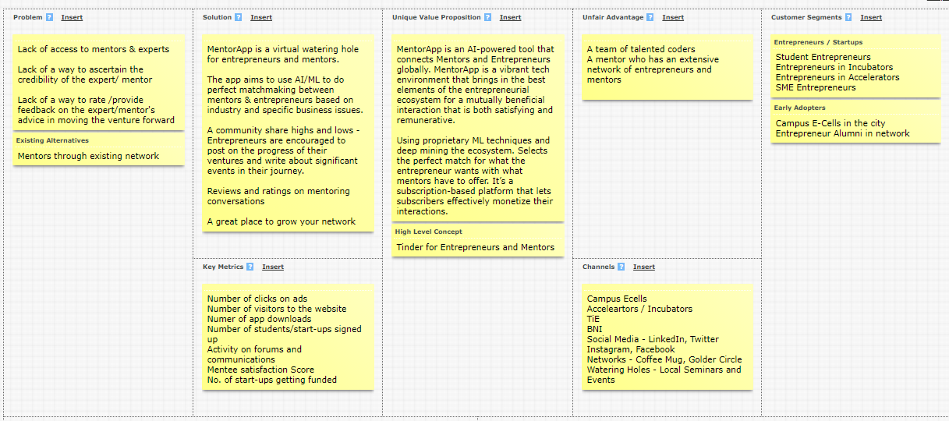
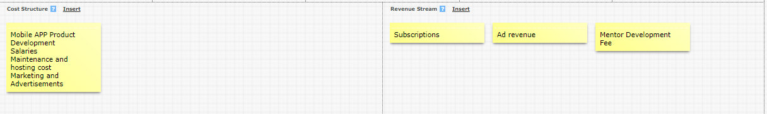
Lean Canvas – Entrepreneur
MENTORAPP
Fostering Connections
Building Community

Slide 15
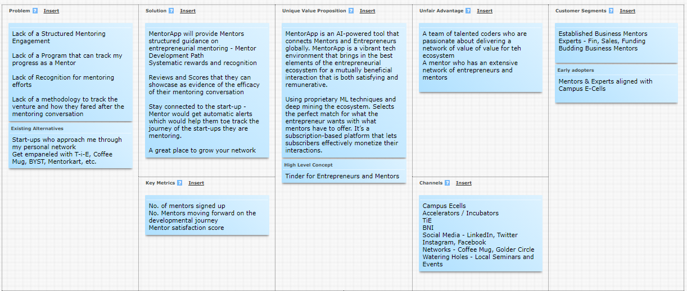
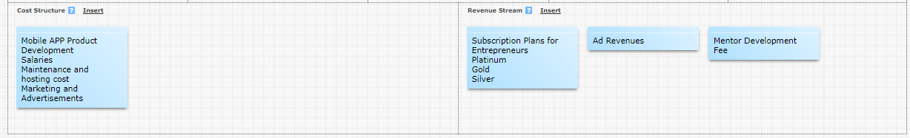
Lean Canvas – Mentors
MENTORAPP
Fostering Connections
Building Community

Slide 16
Competitor Analysis
Benefits
MentorKart
MentorToGo
Headstart
MentorBox
MentorApp
Product
App
Offline Mentoring program + App
Offline Mentoring Program
App
App
Pricing
Rs. 1947 per mentoring session
Pro-bono
Pro-bono
Rs. 449
Subscription
UVP
Hand-holding exclusively for entrepreneurs
India’s first and largest youth mentoring organization
It is an invite-only meetup that provides mentoring to select start-ups
Career mentorship, soft skill development and strategic coaching to make our mentees career ready
Specific App for AI /ML powered match making between start-ups and Mentors. Subscription based platform that lets subscribers effectively monetise their interactions
Branding Channels
Social Media, Networks
Social Media, Networks
Social Media, Networks
Social Media, Networks
Campus E-Cells
Social Media, Networks
Market Review
3.2
4
No reviews found
4.9
-

Slide 17
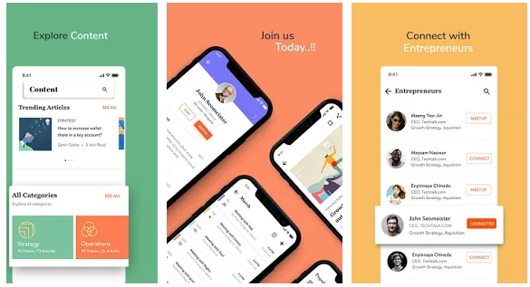
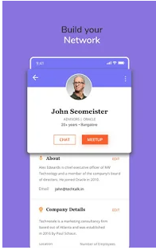
MVP-1
MENTORAPP
Fostering Connections
Building Community

Slide 18
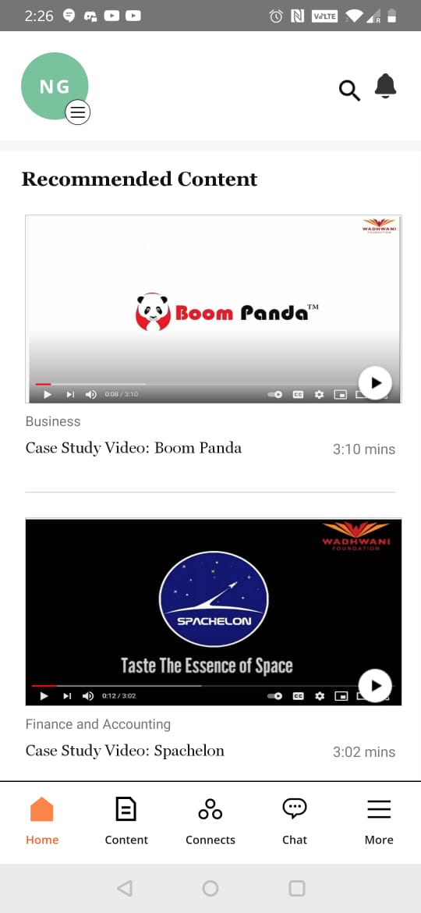
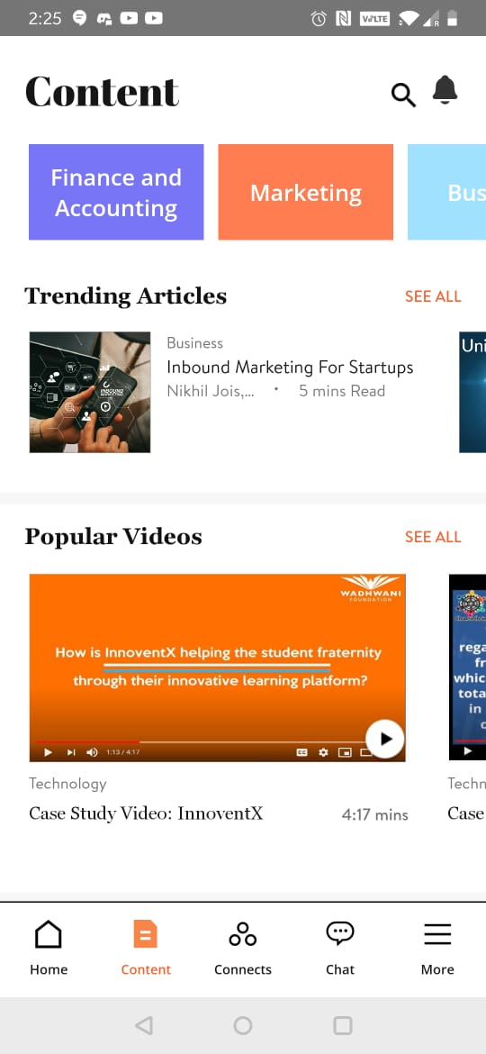
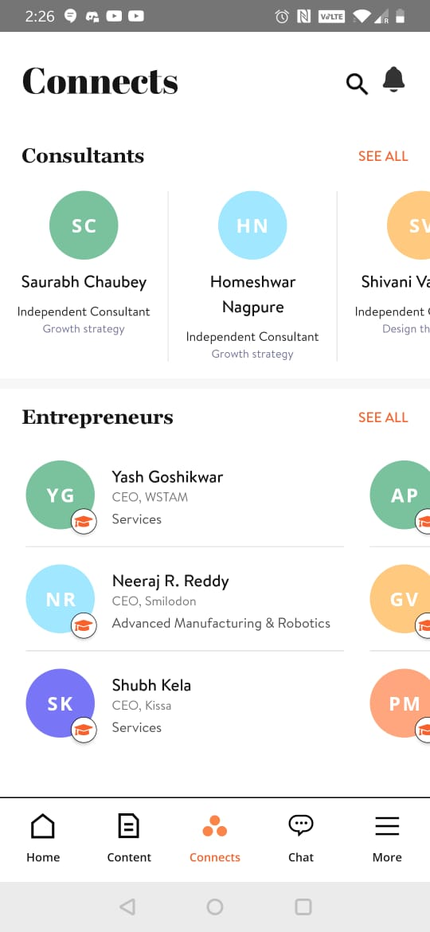
MVP-2

Slide 19
MVP Validation
90/100 entrepreneurs who were surveyed at the beginning participated in the MVP validation and used the app for 15 days.
Qualitative Feedback
Good
The app layout is designed well and is easy to navigate
The search for mentor option gives right mentors with right key words
Improvement
The app is a bit slow sometime and stops working
The chat feature allows the user to share phone numbers etc. That should be controlled.
Expertise and domain-specific search will improve the overall search and match making
An inbuilt feature to record meetings will be helpful
50/50 mentors who were surveyed at the beginning participated in the MVP validation and used the app for 15 days.
Qualitative Feedback
Good
The app provides the right match making
The design look good
Improvement
The UX is not so good, it lags sometime and stops working
Sector wise startup search should be present
An automatic email notification with calendar invite should be added

Slide 20
Start-up Costs
Starting Costs
Startup Cost | ₹3,35,000
Business Registration fees | ₹15,000
Product Development | ₹95,000
Website Design | ₹20,000
Website Development | ₹55,000
Computer Systems | ₹1,50,000
Capital Work in Progress ( Fixed Asset ) | ₹2,50,000
Additional Workstation | ₹2,50,000
Starting Operations ( Budgeted ) | ₹4,15,000
Product Launch Expenses | ₹1,25,000
Rental expenses | ₹2,10,000
Stationery and office supplies | ₹10,000
Miscellanous | ₹75,000
Start-up capital | ₹10,00,000
Share Captial (by Team) | ₹5,00,000
Loans (from Bank or Others) | ₹5,00,000
Explanation
The basic starting cost is the website design and development cost and the cost of office computers.
We haven't considered a fixed deposit for office space since they'll be working out of college. The cost of a Chartered Accountant company registration is taken into account.
The total startup investment is INR 10,00,000. Half of the amount is invested by founders and the other half is interest-free loan from friends and family.

Slide 21
Forecast P&L
Profit & Loss Account ( Income Statement)
 | Jan | Feb | Mar | Apr | May | Jun | Jul | Aug | Sep | Oct | Nov | Dec | Totals
Sales
Cash Sales | ₹ 5,00,000 | ₹ 7,50,000 | ₹ 10,00,000 | ₹ 14,00,000 | ₹ 19,00,000 | ₹ 25,00,000 | ₹ 32,00,000 | ₹ 40,00,000 | ₹ 47,00,000 | ₹ 55,00,000 | ₹ 62,50,000 | ₹ 70,00,000 | ₹ 3,87,00,000
No. of Units Sold | 50 | 75 | 100 | 140 | 190 | 250 | 320 | 400 | 470 | 550 | 625 | 700 | 3870
Price Per Unit | ₹ 10,000 | ₹ 10,000 | ₹ 10,000 | ₹ 10,000 | ₹ 10,000 | ₹ 10,000 | ₹ 10,000 | ₹ 10,000 | ₹ 10,000 | ₹ 10,000 | ₹ 10,000 | ₹ 10,000 | ₹ 10,000
Other Cash Receipts
Total Sales | ₹ 5,00,000 | ₹ 7,50,000 | ₹ 10,00,000 | ₹ 14,00,000 | ₹ 19,00,000 | ₹ 25,00,000 | ₹ 32,00,000 | ₹ 40,00,000 | ₹ 47,00,000 | ₹ 55,00,000 | ₹ 62,50,000 | ₹ 70,00,000 | ₹ 3,87,00,000
COGS
Cost of Services | ₹ 3,50,000 | ₹ 5,25,000 | ₹ 7,00,000 | ₹ 9,80,000 | ₹ 13,30,000 | ₹ 17,50,000 | ₹ 22,40,000 | ₹ 28,00,000 | ₹ 32,90,000 | ₹ 38,50,000 | ₹ 43,75,000 | ₹ 49,00,000 | ₹ 2,70,90,000
Cost Per Unit | ₹ 7,000 | ₹ 7,000 | ₹ 7,000 | ₹ 7,000 | ₹ 7,000 | ₹ 7,000 | ₹ 7,000 | ₹ 7,000 | ₹ 7,000 | ₹ 7,000 | ₹ 7,000 | ₹ 7,000 | ₹ 7,000
Gross profit | ₹ 1,50,000 | ₹ 2,25,000 | ₹ 3,00,000 | ₹ 4,20,000 | ₹ 5,70,000 | ₹ 7,50,000 | ₹ 9,60,000 | ₹ 12,00,000 | ₹ 14,10,000 | ₹ 16,50,000 | ₹ 18,75,000 | ₹ 21,00,000 | ₹ 1,16,10,000
Fixed Expenses
Salaries | ₹ 60,000 | ₹ 60,000 | ₹ 60,000 | ₹ 60,000 | ₹ 85,000 | ₹ 85,000 | ₹ 1,05,000 | ₹ 1,05,000 | ₹ 1,35,000 | ₹ 1,35,000 | ₹ 1,50,000 | ₹ 1,50,000 | ₹ 11,90,000
Marketing and Promotion | ₹ 42,000 | ₹ 42,000 | ₹ 42,000 | ₹ 42,000 | ₹ 42,000 | ₹ 42,000 | ₹ 42,000 | ₹ 42,000 | ₹ 42,000 | ₹ 42,000 | ₹ 42,000 | ₹ 42,000 | ₹ 5,04,000
Digital Marketing & Cust Services | ₹ 80,000 | ₹ 80,000 | ₹ 80,000 | ₹ 80,000 | ₹ 80,000 | ₹ 80,000 | ₹ 80,000 | ₹ 80,000 | ₹ 80,000 | ₹ 80,000 | ₹ 80,000 | ₹ 80,000 | ₹ 9,60,000
Utilities (Electricity etc.) | ₹ 15,000 | ₹ 15,000 | ₹ 15,000 | ₹ 15,000 | ₹ 15,000 | ₹ 15,000 | ₹ 15,000 | ₹ 15,000 | ₹ 15,000 | ₹ 15,000 | ₹ 15,000 | ₹ 15,000 | ₹ 1,80,000
Office Supplies & Misc | ₹ 10,000 | ₹ 10,000 | ₹ 10,000 | ₹ 10,000 | ₹ 10,000 | ₹ 10,000 | ₹ 10,000 | ₹ 10,000 | ₹ 10,000 | ₹ 10,000 | ₹ 10,000 | ₹ 10,000 | ₹ 1,20,000
Rent | ₹ 35,000 | ₹ 35,000 | ₹ 35,000 | ₹ 35,000 | ₹ 35,000 | ₹ 35,000 | ₹ 35,000 | ₹ 35,000 | ₹ 35,000 | ₹ 35,000 | ₹ 35,000 | ₹ 35,000 | ₹ 4,20,000
Total Expenses | ₹ 2,42,000 | ₹ 2,42,000 | ₹ 2,42,000 | ₹ 2,42,000 | ₹ 2,67,000 | ₹ 2,67,000 | ₹ 2,87,000 | ₹ 2,87,000 | ₹ 3,17,000 | ₹ 3,17,000 | ₹ 3,32,000 | ₹ 3,32,000 | ₹ 33,74,000
Result
Net Profit/Loss | ₹ -92,000 | ₹ -17,000 | ₹ 58,000 | ₹ 1,78,000 | ₹ 3,03,000 | ₹ 4,83,000 | ₹ 6,73,000 | ₹ 9,13,000 | ₹ 10,93,000 | ₹ 13,33,000 | ₹ 15,43,000 | ₹ 17,68,000 | ₹ 82,36,000
Gross Profit Margin | 30% | 30% | 30% | 30% | 30% | 30% | 30% | 30% | 30% | 30% | 30% | 30% | 30%
Net Profit Margin | -18% | -2% | 6% | 13% | 16% | 19% | 21% | 23% | 23% | 24% | 25% | 25% | 21%
Explanation
The products being sold are ‘One Hour of Mentoring’ for now. These are one on one sessions that are paid for by the mentee, purchased in advance in size of 10hr packs . There could be additional revenues by way of in-line app advertising at a later stage. Refer to the Financial statement sheet here.

Slide 22
Forecast Cash flow
Cash flow forecast
 | Jan | Feb | Mar | Apr | May | Jun | Jul | Aug | Sep | Oct | Nov | Dec
Starting Cash Position | 6,65,000 | 5,73,000 | 5,56,000 | 6,14,000 | 7,92,000 | 10,45,000 | 15,28,000 | 21,51,000 | 30,64,000 | 40,57,000 | 53,90,000 | 68,83,000
Cash Inflows
Total Sales | 5,00,000 | 7,50,000 | 10,00,000 | 14,00,000 | 19,00,000 | 25,00,000 | 32,00,000 | 40,00,000 | 47,00,000 | 55,00,000 | 62,50,000 | 70,00,000
Cash Outflows
Cost Of Goods Sold | 3,50,000 | 5,25,000 | 7,00,000 | 9,80,000 | 13,30,000 | 17,50,000 | 22,40,000 | 28,00,000 | 32,90,000 | 38,50,000 | 43,75,000 | 49,00,000
Operating Expenses | 2,42,000 | 2,42,000 | 2,42,000 | 2,42,000 | 2,67,000 | 2,67,000 | 2,87,000 | 2,87,000 | 3,17,000 | 3,17,000 | 3,32,000 | 3,32,000
New Fixed Assets Purchased |  |  |  |  | 50000 |  | 50000 |  | 100000 |  | 50000
Loan Payments
Total | 5,92,000 | 7,67,000 | 9,42,000 | 12,22,000 | 16,47,000 | 20,17,000 | 25,77,000 | 30,87,000 | 37,07,000 | 41,67,000 | 47,57,000 | 52,32,000
Result
Change during month | -92,000 | -17,000 | 58,000 | 1,78,000 | 2,53,000 | 4,83,000 | 6,23,000 | 9,13,000 | 9,93,000 | 13,33,000 | 14,93,000 | 17,68,000
Closing cash position | 5,73,000 | 5,56,000 | 6,14,000 | 7,92,000 | 10,45,000 | 15,28,000 | 21,51,000 | 30,64,000 | 40,57,000 | 53,90,000 | 68,83,000 | 86,51,000

Slide 23
Forecast Balance Sheet
Break-Even Analysis
Balance sheet forecast
The numbers reflected on this Balance Sheet are computed as of: | As of Dec 31st
Assets | ₹ 92,36,000
Current assets | ₹ 86,51,000
Cash in hand | ₹ 86,51,000
Petty cash ( cash lying in office )
Accounts Receivable ( Debtors )
Stock on hand (Inventory)
Other Assets
Fixed assets | ₹ 2,50,000
Equipment for Quality Control | ₹ 2,50,000
Furniture
Capital Investment ( Startup Capital ) | ₹ 3,35,000
Liabilities | ₹ 92,36,000
Current liabilities | ₹ -
Accounts payable ( Creditors )
Interest payable
Any Other Amounts Owed
Long-term liabilities | ₹ 5,00,000
Loans from Bank | ₹ 5,00,000
Loans from Friends and Family
Networth of the Promoters | ₹ 87,36,000
Reserves & Surplus ( Retained Earnings) | ₹ 82,36,000
Equity Share Capital | ₹ 5,00,000
Break-even analysis
Average sales price per unit | ₹ 10,000
Average cost of each unit | ₹ 7,000
Gross Profit Margin | 30%
Fixed costs for the year | ₹ 33,74,000
Sales required to break even | ₹ 1,12,46,667
Number of unit sales to break even | 1125
Gross Margin % of Sales
Gross Profit for the year | ₹ 1,16,10,000
Total Sales for the year | ₹ 3,87,00,000
Contribution Margin | 30%
Gross Margin/Total Sales | 30%
Total Fixed Expenses
Operating Expenses | ₹ 33,74,000
Breakeven Sales (Annual)
Gross Margin % of Sales | 30%
Total Fixed Expenses | ₹ 33,74,000
Yearly Breakeven Amount | ₹ 1,12,46,667
Monthly Breakeven Amount | ₹ 9,37,222

Slide 24
Unit Economics
P & L/ unit | Year 2022
Revenue | ₹ 10,000
COGS | ₹ 7,000
Gross Profit | ₹ 3,000
Gross Profit Margin | 30%
Operating Costs | ₹ 7,872
Operating Profit | ₹ 2128
Unit Economics | Year 2022
CAC | ₹ 378
CLV | ₹ 4,031
ARPU | ₹ 12,900
The above is the Unit Economics for year 1 (year 2022). Refer to P&L statement for year 1 in slide 21.
Assumptions (Year 2022)
3000 customers purchase 3780 subscriptions
Churn rate = 96% (A customer subscription once and stays for only for 1 month) Depreciation and Amortization have been assumed to be 0% Since it is a subscription package for 1 month, it is assumed that more than 90% of customers will buy it only once, hence if the customers at the beginning are 50 at the end of 1 month around 2 will be retained. In this case, the churn rate is very high 96%, but for a venture like Mentorapp which is dependent mostly on new customers makes sense.
​Terms | Explanation (For the actual calculations, refer to the Financial Plan Excel sheet link)​
CAC​ | (Cost of Sales + Cost of Marketing ) / Number of new customers acquired (in currency terms)​
CLV | Average purchase value x Average purchase frequency x Average Customer Lifespan x Gross Margin
ARPU​ | Total revenue in specific period/Total number of customers during the same period (in currency terms)​
GROSS PROFIT​ | Total revenue – Total COGS (In currency terms)​
OPERATING COSTS | Cost of goods sold (COGS) + operating expenses (OPEX)
OPERATING PROFIT | Revenue from Core Operations – Cost of Goods Sold – Operating Expenses – Depreciation – Amortization Expenses
CHURN RATE | (Customers at the beginning of the period – customers at the end of the period) / customers at the beginning of the period

Slide 25
Sales Funnel
MARKET SEGMENT and CHANNELS
Target Market: 6M Entrepreneurs & 0.6M Mentors
PROSPECTS: 60K Entrepreneurs & 6K Mentors
CUSTOMER: 6K Entrepreneurs & 600 Mentors
LEADS: 600K Entrepreneurs & 60K Mentors
6M entrepreneurs are looking for mentoring
There are 0.6 M mentors. The mentor market needs to develop and grow to meet the demand of the entrepreneurs.
Presently, there is dearth of structured mentor development programs
At first, the market will be served by getting these 0.6 M mentors on board.
As the model matures, entrepreneurs would also become mentors and thus keep feeding back to the mentor pool.
*This sales funnel is for one year

Slide 26
Marketing and Sales
Brand Logo
POSITIONING STATEMENT
MARKET SEGMENT and CHANNELS
For Entrepreneurs and Mentors, who want to connect with each other, MentorApp is an AI-powered Tinder-like tool that connects Mentors and Entrepreneurs globally. MentorApp is a vibrant tech environment that brings in the best elements of the entrepreneurial ecosystem for a mutually beneficial interaction that is both satisfying and remunerative. Unlike a few existing platforms, with its unique AI-powered platform using proprietary ML techniques and deep mining ecosystem, it selects the perfect match for what the entrepreneur wants with what mentors have to offer. It’s a subscription-based platform that lets subscribers effectively monetize their interactions.
Market Segments
Customers:
Early Adopters:
Entrepreneurs who are in need of Mentors
Mentors who are willing to devote time and share their expertise in
Channels:
Entrepreneur and Mentor Community on LinkedIn and Facebook closed groups
Startup India web page tagging
Sponsor to Entrepreneurship/ Startup Networking Events
Fostering Connections
Building Community

Slide 27
Funding Plan & Projections
 | Year 1 | Year 2 | Year 3 | Year 4 | Year 5
Number of sales | 3870 | 4650 | 5580 | 6700 | 8000
Value of each sale (Contribution) | ₹ 3,000 | ₹ 3,000 | ₹ 4,000 | ₹ 4,000 | ₹ 5,000
Average Price per unit | ₹ 10,000 | ₹ 10,000 | ₹ 12,000 | ₹ 12,000 | ₹ 13,000
Average Cost per unit | ₹ 7,000 | ₹ 7,000 | ₹ 8,000 | ₹ 8,000 | ₹ 8,000
Total revenue | ₹ 3,87,00,000 | ₹ 4,65,00,000 | ₹ 6,69,60,000 | ₹ 8,04,00,000 | ₹ 10,39,96,800
Gross Profit | ₹ 1,16,10,000 | ₹ 1,39,50,000 | ₹ 2,23,18,326 | ₹ 2,67,97,990 | ₹ 4,00,00,000
Capital costs
Land and building | N.A. | N.A. | N.A. | N.A. | N.A.
Equipment | ₹ 2,50,000 | ₹ 10,00,000 |  | ₹ 18,00,000
Product development costs | ₹ 95,000 | ₹ 5,00,000 | ₹ 7,00,000 |  | ₹ 10,00,000
Others | ₹ 3,35,000
Total | ₹ 6,80,000 | ₹ 15,00,000 | ₹ 7,00,000 | ₹ 18,00,000 | ₹ 10,00,000
Expenses (Annual)
Salaries | ₹ 11,90,000 | ₹ 13,09,000 | ₹ 14,39,900 | ₹ 15,83,890 | ₹ 17,42,279
Marketing and Promotion | ₹ 5,04,000 | ₹ 5,54,400 | ₹ 6,09,840 | ₹ 6,70,824 | ₹ 7,37,906
Digital Marketing & Customer Services | ₹ 9,60,000 | ₹ 10,56,000 | ₹ 11,61,600 | ₹ 12,77,760 | ₹ 14,05,536
Utilities (electricity etc.) | ₹ 1,80,000 | ₹ 1,98,000 | ₹ 2,17,800 | ₹ 2,39,580 | ₹ 2,63,538
Office Supplies | ₹ 1,20,000 | ₹ 1,32,000 | ₹ 1,45,200 | ₹ 1,59,720 | ₹ 1,75,692
Rent | ₹ 4,20,000 | ₹ 4,62,000 | ₹ 5,08,200 | ₹ 5,59,020 | ₹ 6,14,922
Total | ₹ 33,74,000 | ₹ 37,11,400 | ₹ 40,82,540 | ₹ 44,90,794 | ₹ 49,39,873
Earnings (EBITDA) | ₹ 82,36,000 | ₹ 1,02,38,600 | ₹ 1,82,35,786 | ₹ 2,23,07,196 | ₹ 3,50,60,127
Note: A 20% YoY linear growth in sales is projected.

Slide 28
Funding Plan & Projections
Funding Needed For | Market Expansion and Product Development for the next 5 years
Current Equity Capital of Founders | The Founders have put in paid up capital of INR 0.5M , they also have a debt of INR 0.5M from family and friends which will be converted into equity at par. Total Capital is INR 1M
Potential Funding Sources | Angel Networks , Seed Funds , HNI’s
Current Valuation of Company | The company is seeking a current valuation of INR 70M based on comparables of 12 P/E on a 5 year projection based on current sales
Target Fund Raise | The company is seeking to raise INR 20M
WIIFM for Investors | 26% equity in the company and a seat on the board
Future Fund Raise | Series A from marquee VC Firms

Slide 29



Team Commitment
Edward John (CEO)
The Visionary – MentorApp has been Edward’s idea. The problem is one that is ‘close to his heart’.
Priyanca Jain (CTO)
The Hacker – Priyanca comes with coding skills par excellence. She already has 2 apps to her credit
Farhan Ahmed ( CMO)
The Hustler – Farhan is a born salesman. He is a mobilizer and has connects with campuses across the country through their e-cells

Slide 30
Thank You!

